Slide 1
Lecture 11 Harmony of the Self with the Body – Prosperity

Slide 2
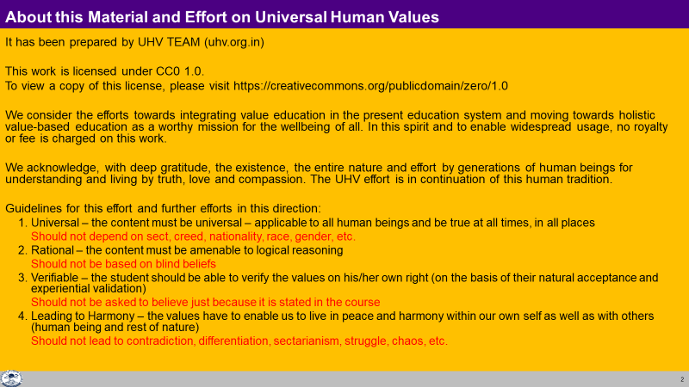

Slide 3
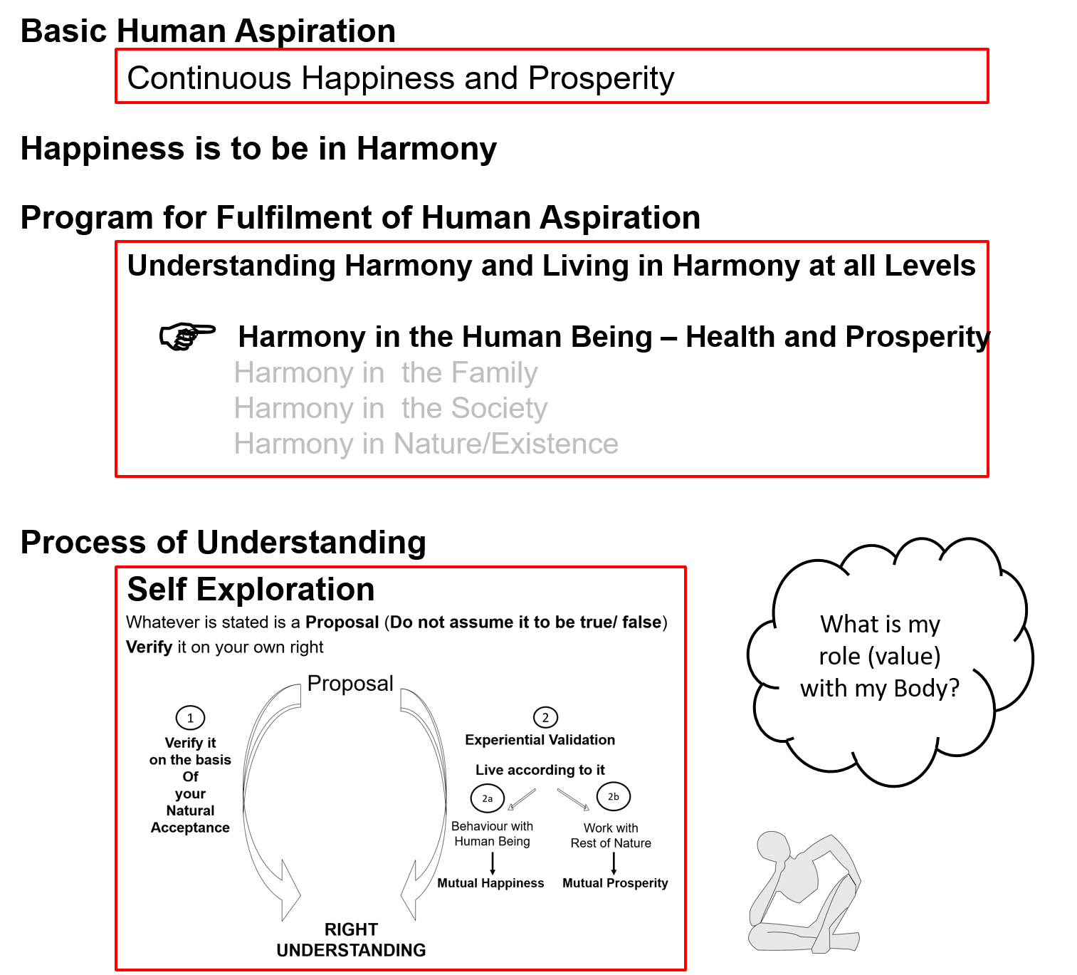

Slide 4
Human Being Ekkuo | Self eSa | Body “kjhj
Need vko';drk | Happiness (e.g. Respect) lq[k ¼tSls lEeku½ | Physical Facility (e.g. Food) lqfo/kk ¼tSls Hkkstu½
In Time dky esa | Continuous fujUrj | Temporary lkef;d
In Quantity ek=k esa | Qualitative (is Feeling) xq.kkRed ¼Hkko gS½ | Quantitative (Required in Limited Quantity) Ekk=kRed ¼lhfer ek=k esa½
Fulfilled By iwfrZ ds fy, | Right Understanding & Right Feeling lgh le>] lgh Hkko | Physio-chemical Things HkkSfrd&jklk;fud oLrq
Activity fØ;k | Desire, Thought, Expectation… bPNk] fopkj] vk”kk--- | Eating, Walking… [kkuk] pyuk---
In Time dky esa | Continuous fujUrj | Temporary lkef;d
Response | Knowing, Assuming, Recognising, Fulfilling tkuuk] ekuuk] igpkuuk] fuokZg djuk | Recognising, Fulfilling igpkuuk] fuokZg djuk
 | Consciousness pSrU; | Material tM+
Co-existence
lgvfLrRo
Notes:
The Self has the potential of knowing. If that potential is not realized, human being operates on the basis of assuming without knowing

Slide 5
Self Body (Instrument)
Consciousness |  | Material
Needs: Happiness, Prosperity → Continuity |  | Physical Facility
Needs & activities are continuous in time |  | Temporary in time
INFORMATION
Instruction
Sensation
Self is central to human existence
Body is
an instrument of the Self

Slide 6
Self Body (Instrument)
Consciousness |  | Material
Needs: Happiness, Prosperity → Continuity |  | Physical Facility
Needs & activities are continuous in time |  | Temporary in time
Self-regulation (संयम)
Feeling of responsibility toward the body – for Nurturing, Protection and Right Utilization of the Body
INFORMATION
Instruction
Sensation
Self is central to human existence
Body is
an instrument of the Self

Slide 7
Self Body (Instrument)
Consciousness |  | Material
Needs: Happiness, Prosperity → Continuity |  | Physical Facility
Needs & activities are continuous in time |  | Temporary in time
Self-regulation (संयम) |  | Health
Feeling of responsibility toward the body – for Nurturing, Protection and Right Utilization of the Body |  | 1. Body acts according to the Self 2. Parts of the body are in harmony (in order)
INFORMATION
Instruction
Sensation
Physical Facility is required to fulfill the responsibility of the Self toward the Body
(to keep the Body in harmony, in good health)
– for nurturing, protection and right utilisation of the body
The required physical facility can be identified
Self is central to human existence
Body is
an instrument of the Self

Slide 8
Self Body (Instrument)
Consciousness |  | Material
Needs: Happiness, Prosperity → Continuity |  | Physical Facility
Needs & activities are continuous in time |  | Temporary in time
Self-regulation (संयम) |  | Health
Feeling of responsibility toward the body – for Nurturing, Protection and Right Utilization of the Body |  | 1. Body acts according to the Self 2. Parts of the body are in harmony (in order)
Food… Clothes, Shelter... Instruments…
INFORMATION
Instruction
Sensation
The required physical facility can be recognised
along with the required quantity
The quantity of food… required for nurturing the body – is it limited or unlimited?
Clothes, shelter… for protection of the body – is it limited or unlimited?
Instruments, equipments… for right utilisation of the body – is it limited or unlimited?
Self is central to human existence
Body is
an instrument of the Self

Slide 9
Self Body (Instrument)
Consciousness |  | Material
Needs: Happiness, Prosperity → Continuity |  | Physical Facility
Needs & activities are continuous in time |  | Temporary in time
Self-regulation (संयम) |  | Health
Feeling of responsibility toward the body – for Nurturing, Protection and Right Utilization of the Body |  | 1. Body acts according to the Self 2. Parts of the body are in harmony (in order)
Food… Clothes, Shelter... Instruments… Required Required Required in a in limited in limited limited quantity quantity quantity
INFORMATION
Instruction
Sensation
Physical Facility is required to to keep the body in good health,
so that right utilisation of the body can be ensured
Physical Facility is required only for
nurturing, protection and right utilisation of the body
If we can see that, the physical facility for
nurturing, protection and right utilisation of the body
is required in a limited quantity,
then we can understand the meaning of prosperity

Slide 10
Prosperity (le`f))
Prosperity – The feeling of having / producing more than required Physical Facility
2 1
le`f) & vko”;d lqfo/kk ls vf/kd dh miyfC/k@ mRiknu dk Hkko
1 2
1 – Identification of required physical facility (including the required quantity)
– with right understanding
vko”;d lqfo/kk dk fu/kkZj.k & lgh le> ls
2 – Ensuring availability/ production of more than required physical facility
– with right skills
vf/kd dh miyfC/k@ mRiknu] HkkSfrd jklk;fud oLrqvksa dk & lgh gquj ls
A prosperous person thinks of right utilisation, nurturing the other
“ deprived “ “ “ accumulation, exploiting “ “
le`) O;fDr lnqi;ksx dk] nwljs dk iks"k.k djus dk lksprk gS
nfjnz “ laxzg “ “ “ “kks"k.k “ “ “ “
Notes:
Production with right skills = cyclic and mutually enriching, avartansheel production aka sustainable production

Slide 11
In a previous session, we had seen that we can observe two categories of human beings
blhfy, vHkh nks rjg ds euq”; fn[kkbZ nsrs gSa&
Lacking physical facility, unhappy deprived (lqfo/kk foghu nq[kh nfjnz )
Having physical facility, unhappy deprived (lqfo/kk laiUu nq[kh nfjnz )
While we want to be – tcfd ge gksuk pkgrs gSa&
Having physical facility, happy prosperous (lqfo/kk laiUu lq[kh le`))
Now we can see that if the identification of required physical facility is missing, then one can only shift between category 1 & category 2
This is possible with
a- the right identification of required physical facility and
b- availability / production of more than required physical facility

Slide 12
Gross Misunderstanding 1 – Human Being = Body
Human Being Ekkuo | Self (I) eSa | = | Body “kjhj
Need vko’;drk | Respect lEeku | = | Physical Facility (Eg. Food, Clothes) lqfo/kk (tSls&Hkkstu] diM+k)
 | Continuous fujUrj | = | Unlimited vlhfer
Feeling of Deprivation
I don’t have enough!
Accumulation = unlimited?
Effort for Physical Facility
by any means?
Accumulation of Physical Facility – Unlimited!
Lqfo/kk laxzg & vlhfer!
Loop
Check if you
are caught up
In this loop
Deprivation
nfjnzrk

Slide 13
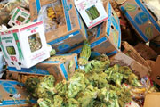
Gross Misunderstanding 2 – Resources are less than our need
Data: Of the 4.2 billion tons of food produced, more than 1 billion tons of food is lost or wasted every year, UN-backed report finds (11 May 2011)
About a third of all the food produced for human consumption each year – or roughly 1.3 billion tons – is lost or wasted, according to a new study commissioned by the United Nations Food and Agriculture Organization (FAO)
Global Food Production is 6 times requirement
Global Food Wastage is 1/3rd of production
Wastage is enough to feed 1300 crore people/year
Have we understood human needs?
Have we understood right utilisation?
Is it a question of production or distribution?
Is it a question of relationship?
Is it a question of right understanding?
It is a question of right education-sanskar
http://www.un.org/apps/news/story.asp?NewsID=38344&Cr=fao&Cr1

Slide 14
Exercise:
Find out how many clothes you need for protection of the body
Are they less, equal to or more than what is needed?
We are prosperous in terms of clothes when we feel that “we have more clothes than needed”…
We feel prosperous when we can see that we have, or we can produce, more physical facility than what we require
Notes:
Right Utilisation – Ensuring right understanding, right feeling… in the Self
Nurturing – Ensures nurturing of the body
Protection – Ensures protection of the body

Slide 15
Sum Up
Human being = co-existence of Self (consciousness) and Body (material)
Self is central to human existence, the Body is used as an instrument
The nurturing, protection and right utilisation of the Body is the responsibility of the Self
Physical facility is required to fulfil that responsibility towards the Body
Physical Facility is required, in a limited quantity, for Nurturing, Protection and Right Utilisation of the Body
Prosperity = Feeling of having / producing more than required physical facility
Identification of required physical facility – with right understanding (including the required quantity)
Ensuring availability/ production of more than required physical facility – with right skills

Slide 16
Self Reflection

Slide 17
Self Reflection
Do you have a feeling of Self-regulation (responsibility toward your body)? – continuous?
Is your body healthy?
Find out – how much physical facility is required in your family; how much physical facility is available. An on that basis are you prosperous or deprived?
Do you have a feeling of prosperity? – continuous?
Do you think of
Right utilisation of physical facility and nurturing others (human beings / rest of nature)?
Accumulating more physical facility or exploiting others?

Slide 18
Practice Session: Is my family prosperous vis-à-vis clothes
Calculate the total quantity of clothes required by your family.
Find out the quantity available.
Are you making right utilization of each pair of clothes?
Is the quantity available less, equal or more than the quantity required?
As far as clothes are concerned, do you feel prosperous or deprived?
Do the same exercise for your other physical needs. For that you can make an inventory of everything in your home (or at least your room). Discuss this with your family and work out your conclusions regarding:
Ability of your family to identify its needs for physical facility, along with the required quantity
How much of each physical facility required is available?
How much of the physical facility is being rightly utilised?
How to fill the gap, if any
The role of physical facility
Meaning of prosperity

Slide 19
Practice Session: Family Prosperity Chart
Physical Facility Needed Quantity Required Quantity Available Prosperous v-v need?
For Nurturing the Body
Food
Air
Sunlight
…
For Protecting the Body
Clothes
Footwear
Shelter (house)
…
For the Right Utilisation of the Body
Communication devices (TV, Radio, Telephone…)
Transportation (cycle, bike, car…)
Tools, Instruments & Gadgets (pliers, laptop, mixie…)
…
Also identify other physical facility which is available but not required for any of the above
Curios, show-pieces
…
Notes:
Also refer to the sample prosperity chart (word file)
We have to understand that prosperity is a feeling, the confidence that my needs will be fulfilled – I already have more than enough or I can produce more than enough (nature has that much available) or my relatives will provide what is needed (I have the relationship, the social support needed)

Slide 20
Key Points
Harmony of the Self with the Body

Slide 22
Human Being Ekkuo | Self eSa | Body “kjhj
Need vko';drk | Happiness (e.g. Respect) lq[k ¼tSls lEeku½ | Physical Facility (e.g. Food) lqfo/kk ¼tSls Hkkstu½
In Time dky esa | Continuous fujUrj | Temporary lkef;d
In Quantity ek=k esa | Qualitative (is Feeling) xq.kkRed ¼Hkko gS½ | Quantitative (Required in Limited Quantity) Ekk=kRed ¼lhfer ek=k esa½
Fulfilled By iwfrZ ds fy, | Right Understanding & Right Feeling lgh le>] lgh Hkko | Physio-chemical Things HkkSfrd&jklk;fud oLrq
Activity fØ;k | Desire, Thought, Expectation… bPNk] fopkj] vk”kk--- | Eating, Walking… [kkuk] pyuk---
In Time dky esa | Continuous fujUrj | Temporary lkef;d
Response | Knowing, Assuming, Recognising, Fulfilling tkuuk] ekuuk] igpkuuk] fuokZg djuk | Recognising, Fulfilling igpkuuk] fuokZg djuk
 | Consciousness pSrU; | Material tM+
Co-existence
lgvfLrRo
Notes:
The Self has the potential of knowing. If that potential is not realized, human being operates on the basis of assuming without knowing

Slide 23
Self Body (Instrument)
Consciousness Self |  | Material Body
Needs: Happiness, Prosperity → Continuity |  | Physical Facility
Needs & activities are continuous in time |  | Temporary in time
Self-regulation (संयम) |  | Health
Feeling of responsibility toward the body – for Nurturing, Protection and Right Utilization of the Body |  | 1. Body acts according to the Self 2. Parts of the body are in harmony (in order)
Food… Clothes, Shelter... Instruments… Required Required Required in a in limited in limited limited quantity quantity quantity
INFORMATION
Instruction
Sensation
Physical Facility is required to to keep the body in good health,
so that right utilisation of the body can be ensured
i.e. physical Facility is required only for
nurturing, protection and right utilisation of the body
If we can see that, the physical facility for
nurturing, protection and right utilisation of the body
is required in a limited quantity,
then we can understand the meaning of prosperity

Slide 24
Prosperity (le`f))
Prosperity – The feeling of having / producing more than required Physical Facility
2 1
le`f) & vko”;d lqfo/kk ls vf/kd dh miyfC/k@ mRiknu dk Hkko
1 2
1 – Identification of required physical facility (including the required quantity)
– with right understanding
vko”;d lqfo/kk dk fu/kkZj.k & lgh le> ls
2 – Ensuring availability/ production of more than required physical facility
– with right skills
vf/kd dh miyfC/k@ mRiknu] HkkSfrd jklk;fud oLrqvksa dk & lgh gquj ls
A prosperous person thinks of right utilisation, nurturing the other
“ deprived “ “ “ accumulation, exploiting “ “
le`) O;fDr lnqi;ksx dk] nwljs dk iks"k.k djus dk lksprk gS
nfjnz “ laxzg “ “ “ “kks"k.k “ “ “ “

Slide 25
Gross Misunderstanding 1 – Human Being = Body
Human Being Ekkuo | Self (I) eSa | = | Body “kjhj
Need vko’;drk | Respect lEeku | = | Physical Facility (Eg. Food, Clothes) lqfo/kk (tSls&Hkkstu] diM+k)
 | Continuous fujUrj | = | Unlimited vlhfer
Feeling of Deprivation
I don’t have enough!
Accumulation = unlimited?
Effort for Physical Facility
by any means?
Accumulation of Physical Facility – Unlimited!
Lqfo/kk laxzg & vlhfer!
Loop
Check if you
are caught up
In this loop
Deprivation
nfjnzrk

Slide 26
Gross Misunderstanding 2 – Resources are less than our need
Data: Of the 4.2 billion tons of food produced, more than 1 billion tons of food is lost or wasted every year, UN-backed report finds (11 May 2011)
About a third of all the food produced for human consumption each year – or roughly 1.3 billion tons – is lost or wasted, according to a new study commissioned by the United Nations Food and Agriculture Organization (FAO)
Global Food Production is 6 times requirement
Global Food Wastage is 1/3rd of production
Wastage is enough to feed 1300 crore people/year
Have we understood human needs?
Have we understood right utilisation?
Is it a question of production or distribution?
Is it a question of relationship?
Is it a question of right understanding?
It is a question of right education-sanskar
http://www.un.org/apps/news/story.asp?NewsID=38344&Cr=fao&Cr1

Slide 27
Right Utilisation of Physical Facility
Purposefulness –
Transformation
Right Utilisation – Relationship,
Order
Utilisation – Family
Use – Body
Indulgence – Taste
Over Indulgence
Obsession for Indulgence
– Sensual
Pleasure
Á;kstuh;rk & thou tkx`fr
lnqi;ksx & laca/k] O;oLFkk
mi;ksx & ifjokj
miHkksx & 'kjhj
Hkksx & bafæ; lq[k
cgqHkksx
vfrHkksx ¼Hkksx mUekn½
KkuiwoZd
With Right Understanding
vKkurko'k
Without Right Understanding

Slide 28
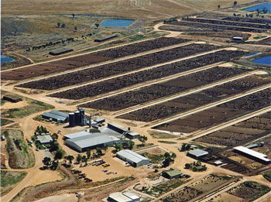
Even Small Individual Choices Add Up E.g. Choice of Food
20% of all life produced on land every year is harvested for human purposes
14-16 kg grain & 21,000 litres of water → 1 kg meat
The world's cattle alone (not including other livestock) annually consume food grains enough for 8.7 billion people
Land use – 3¼ acres/person on meat diet vs 0.2 acres/person on veg diet
20% Amazon rain forest (the size of California) destroyed since 1970
80% of this land is used for cattle raising
By feeding grain to livestock, we lose 90% of the protein, 96% of the calories, 99% of its carbohydrates, and 100% of the fiber. Animal-based diets are high in saturated fat, excessive protein and cholesterol, leading to heart disease and stroke (nearly 50% of all deaths in the US)
Video (1 min)
http://www.planetaryrenewal.org/ipr/vegetarian.html

Slide 29
Sum Up
Human being = co-existence of Self (consciousness) and Body (material)
Self is central to human existence, the Body is used as an instrument
The nurturing, protection and right utilisation of the Body is the responsibility of the Self
Physical facility is required to fulfil that responsibility towards the Body
Physical Facility is required, in a limited quantity, for Nurturing, Protection & Right Utilisation of the Body
Prosperity = Feeling of having / producing more than required physical facility
Identification of required physical facility (including the required quantity) – with right understanding
Ensuring availability/ production of more than required physical facility – with right skills

Slide 30
FAQs for Lecture 11
Harmony of the Self with the Body

Slide 31
Preamble
Now with the clarity of human being as co-existence of Self and Body, the needs can be more precisely identified and prosperity can be discussed with more definiteness
While many questions regarding prosperity have been discussed in earlier lectures (particularly lectures 3, 5 and 6), we can revisit some of these questions and discuss few new questions

Slide 32
Question(s): Response
Why do we need “more than required” physical facility to feel prosperous?
To ensure Prosperity-
We identify the required physical facility for the family (including the required quantity) – with right understanding
We produce more than the required physical facility using cyclic, mutually enriching process – with right skills
We consume as much as is required (for nurturing, protection & right utilisation of the body), and not more – with a feeling of Self-regulation
We share the rest for mutual fulfillment in relationship and for order in society – with a sense of responsibility in relationship
So that more is for sharing in relationship, not for indulgence or over-consumption.

Slide 33
Question(s): Response
Can we really identify our need? How much money is really required- can we determine?
I am asking because prices keep changing and there is no guarantee that we will not have some accident or some illness where we don’t know how much the treatment will cost. We have to include insurance for all these contingencies…
We can certainly identify the need of physical facility for nurturing, protection and right utilisation of the body as discussed in the session.
However, when we try to convert it into money or any currency, there may be problem because the terms of exchange of physical facility with respect to money (or currency) is defined by the human being, by the prevailing norms in the society. In societal setup where there is unequal terms of exchange (therefore injustice) then certain physical facility may be assigned low price and certain other facilities may be assigned very high price. Even knowledge and feeling which is the activity of consciousness can become a mode of getting money.
Continued…

Slide 34
Response (continued)
If value in terms of money assigned to a particular facility is not defined on the basis of labour that has been put up in producing that facility and its utility then any value can be assigned to the physical facility depending upon the prevailing norms of the society.
Example- Cost of a bread may be 1 rupee when you have to prepare it in home but it may cost 10 rupees or even 100 rupees when you are in a restaurent.
When I was studying at IIT Kanpur, Education fee was 250 rupees per semester, now it is around 1 lakh.
As far as your health problem is concerned, you will never be able to decide how much money will be required, so even insurance will not work.
And when you talk about health, are you talking about keeping your body healthy or getting treatment
One fundamental question regarding insurance is that whether the assurance is in accumulation of physical facility or in relationship and societal system.

Slide 35
Response (continued)
Body Physical Facility Money (Currrency) Digital currency…
Terms of Exchange between
- PF … Currency
- currency 1 … currency 2
(now even Knowledge and currency)
Possible to identify qty Difficult to identify amount of money as
In terms of PF indefinite, unequal terms of exchange…
Existential realities Construct of human being
Governed by Governed by
Existential laws Prevailing man-made regulations
Universal, Definite… Vary from place to place, indefinite…
(made by human beings with right understanding, right feeling?)
(or by people with assumptions, feeling of opposition…?)

Slide 36
Question(s): Response
It is said that “desires are unlimited, resources are limited”. So how can there be prosperity?
Desires, if we understand properly, is definite i.e., continuity of happiness and prosperity.
The amount of physical facility required for ensuring prosperity is limited and can be identified.
Availability of resources in nature and capacity to produce in human being is more than what is required.
Therefore, prosperity is possible for everyone.

Slide 37
Question(s): Response
So many great inventions took place during world wars, like operations research, like radar… If we become satisfied, then there will be no motivation for development. What is your comment on it?
We certainly need development, but, for what? For satisfaction, for fulfillment, isn’t it? How can there be a development which is against satisfaction?
The problem today is that we have not been able to define our need with definiteness, therefore, there is no completion point, it is undefined, open ended. Now, irregard if whatever we achieve, we remain dissatisfied.
As a result, development has no completion point, it is undefined, open ended; we are moving forward but, we don’t know where we want to reach- no clarity about the goal and therefore, the development today is directionless.
…continued

Slide 38
Question(s): Response
So many great inventions took place during world wars, like operations research, like radar… If we become satisfied, then there will be no motivation for development. What is your comment on it?
…continued
We need to work out a process of development with a well defined goal and definite direction. This is what we are trying to do.

